Slide 1
05 | Security
Jeremy Likness | Principal Architect
Christopher Harrison | Content Developer

Slide 2
Module Overview
Authentication in the Host
Authentication using Message Handlers
Token-based Authentication
Authorization Filters
Custom Authorization Filters
Role-based Authorization
Preventing Cross-Site Request Forgery

Slide 3
Authentication in the Host
Configuring your Web API Project

Slide 4
Authentication in the Host
Authentication
Who are you?
Authorization
What are you allowed to do?
Identity
Permissions

Slide 5
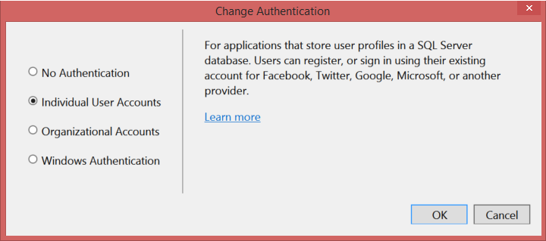
Authentication in the Host
Default assumption by Web API
Usually MVC or other app as “wrapper”

Slide 6
Authentication in the Host
Notes:
05aHostAuthentication – show /api/auth and /api/auth/secured, then register, log in, and show again

Slide 7
Authentication using Message Handlers
Fine-grained control

Slide 8
Authentication using Message Handlers
Derive from DelegatingHandler
Override SendAsync
Look for credentials as needed
If the user is authorized, create an identity
Create a principal based on the identity
Set the current user for the context (you may also set the thread principal, but this will affect how other operations are performed)

Slide 9
Authentication Using Message Handlers
Notes:
05bMessageHandlerAuthentication – add UserName to headers to authenticate

Slide 10
Token-based Authentication
You do hang onto your tokens, don’t you?

Slide 11
Token-based Authentication
Authorization generates a token
Tokens given access to resources
Protects revealing password to app if token is generated by a third-party (i.e. Facebook, Google, Microsoft Account, Twitter, etc.)
A controller with support is generated in the Web API template when you select “individual accounts”
Token is passed in the header
Can also create your own provider/parser

Slide 12
Token-based Authentication
Notes:
05cTokenBasedAuthentication
POST /api/account/Register (Email, Password, ConfirmPassword)
Checkout source in the Index.cshtml

Slide 13
Authorization Filters
Attribute it to security

Slide 14
Authorization Filters
Authorize is based on existing user and roles
AuthorizationFilter enables more complex (synchronous) scenarios
IAuthorizationFilter allows for asynchronous logic
Can be applied at action, controller, or global level
Authorize is the only function “out of the box”
Filters require customization

Slide 15
Custom Authorization Filters
Security done your way

Slide 16
Custom Authorization Filters
More specific than message handler
Typically derive from AuthorizationFilterAttribute
For asynchronous tasks, implement IAuthorizationFilter
Override OnAuthorization

Slide 17
Custom Authorization Filters
Notes:
05dAuthorizationFilter
/api/auth
/api/auth/secured

Slide 18
Role-based Authorization
A role-playing API

Slide 19
Role-based Authorization
Authorize allows you to specify users
This doesn’t scale well
Roles provide a scalable means of authorization access to resources
Use attribute-based to lock down entire resource
Use IsInRole for custom logic based on roles
Set up roles in your authentication logic

Slide 20
Role-based Authorization
Notes:
05eRoleBasedAuthorization – roles of ivision (@ivision.com), Microsoft (@Microsoft.com) or admin (admin@)
/api/widgets, /api/widgets/ivision, /api/widgets/Microsoft, /api/widgets/all

Slide 21
Preventing Cross-Site Request Forgery
Your public service anti-XSRF message

Slide 22
Cross-Site Request Forgery (CSRF)
Malicious attack
Post to your site from third-party site
Takes advantage of the cookie generated for the user
To prevent, use anti-forgery tokens
Documents on two different sites cannot access each other’s content, so you can embed token in the page on your site but malicious site won’t know what it is
Especially important if you enable CORS (cross-origin resource sharing)

Slide 23
Anti-Forgery
Generate Token on Server and Send to Page
Add Token to Header in Requests
Validate Token on Server

Slide 24
Anti-Forgery Tokens
Notes:
05fAntiForgery – show ForgeryController, Index.cshtml, and AntiForgeryHandler

